Slide 1
CIS 4930-001: Introduction to Augmented and Virtual Reality
Design for AR/VR

Slide 2
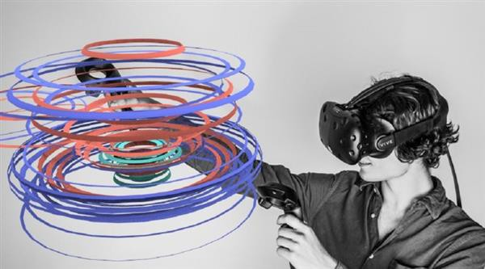
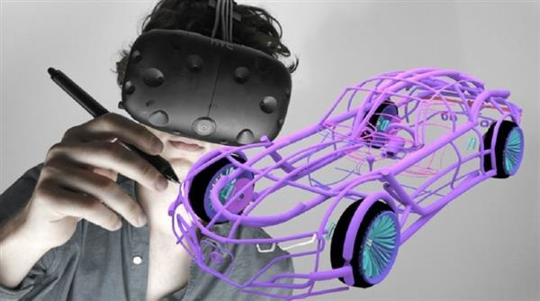
How Can we Design AR/VR experiences that meet real needs

Slide 3
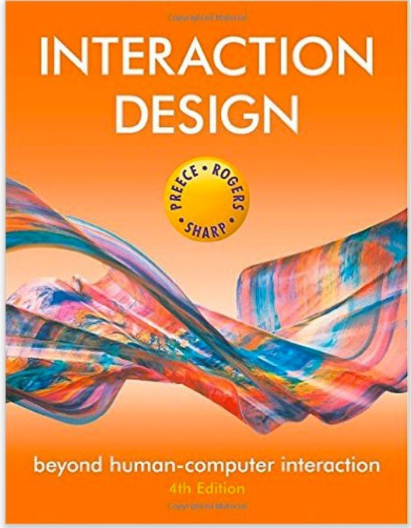
What is Interaction Design ?
“Designing interactive products to support people in their everyday and working lives”
J. Preece, Interaction Design, 2002.
Interaction Design is the design of user experience with technology

Slide 4
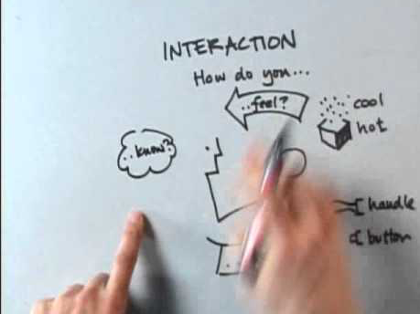
Bill Verplank on Interaction Design
https://youtu.be/Gk6XAmALOWI

Slide 5
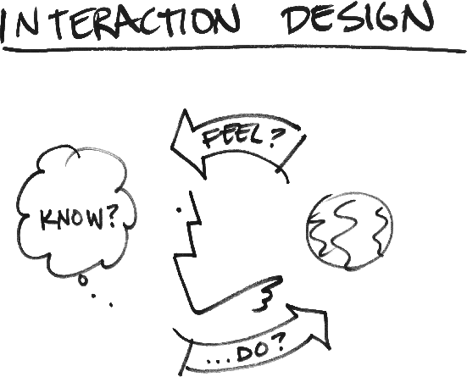
Interaction Design involves answering three questions:
What do you do? – How do you affect the world?
What do you feel? – What do you sense of the world?
What do you know? – What do you learn?
Bill Verplank

Slide 6
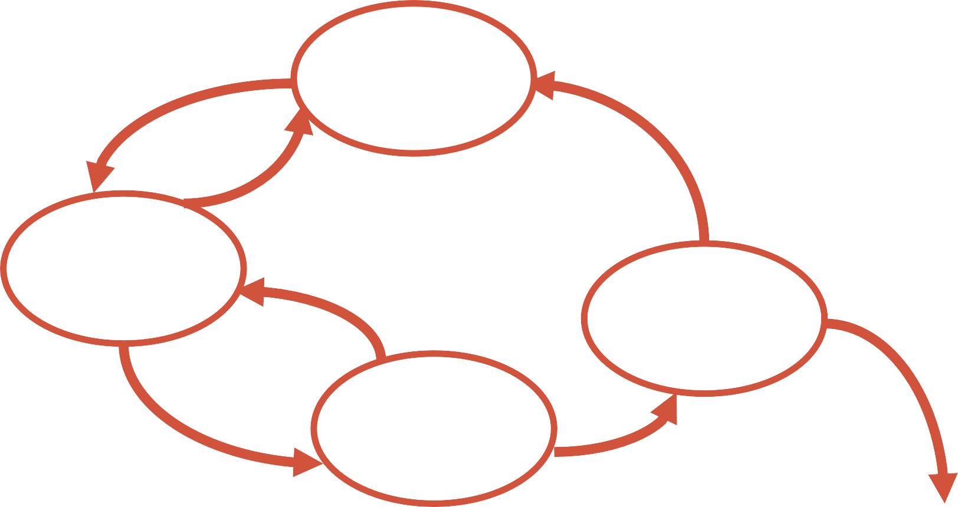
The Interaction Design Process
Develop alternative prototypes/concepts and compare them
And iterate, iterate, iterate....
Identify needs/ establish requirements
(Re)Design
Evaluate
Build an interactive version
Final Product

Slide 7
NEEDS ANALYSIS
Identify needs/ establish requirements
(Re)Design
Evaluate
Build an interactive version
Final Product

Slide 8
Needs Analysis Goals
Create a deep understanding of the user and problem space
Understand how AR/VR can help address the user needs

Slide 9
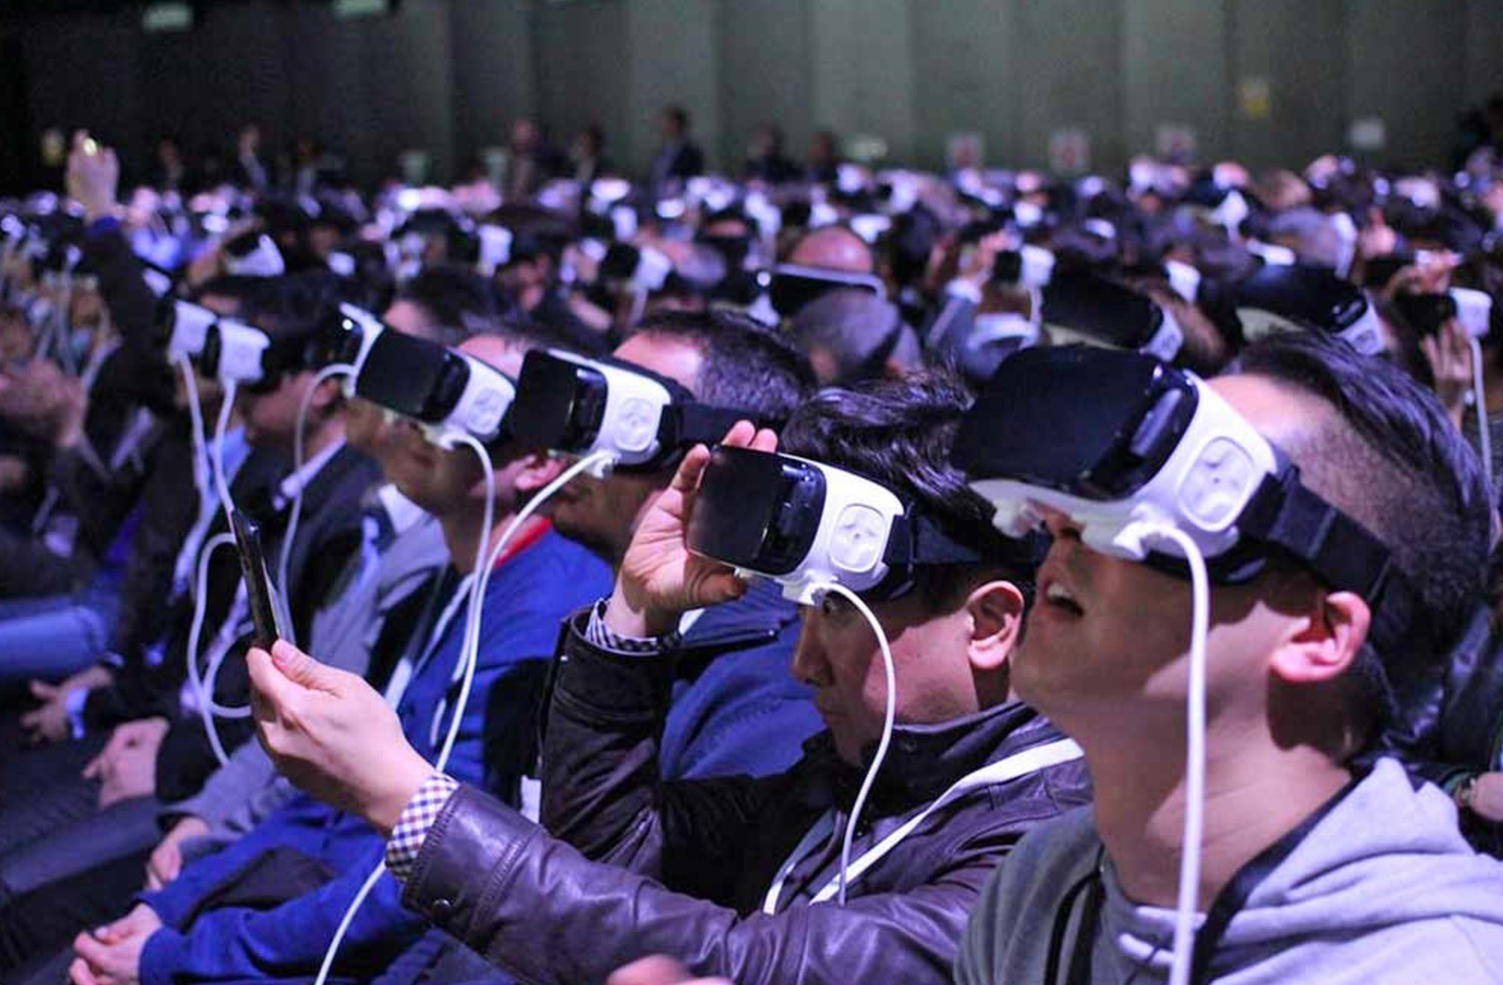
Key Questions
Who is the user?
Different types of users
What are the user needs?
Understand the user, look for insights
Can VR address those needs?
VR cannot solve all problems

Slide 10
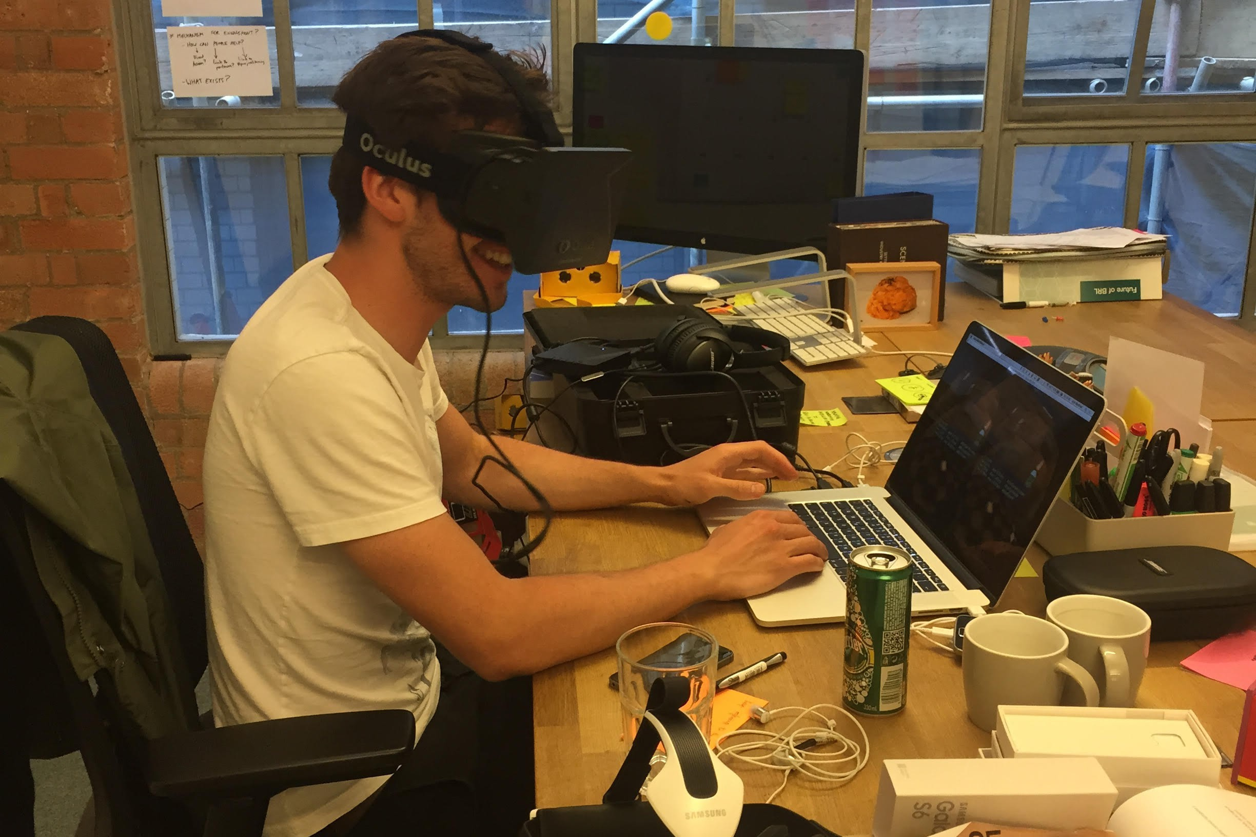
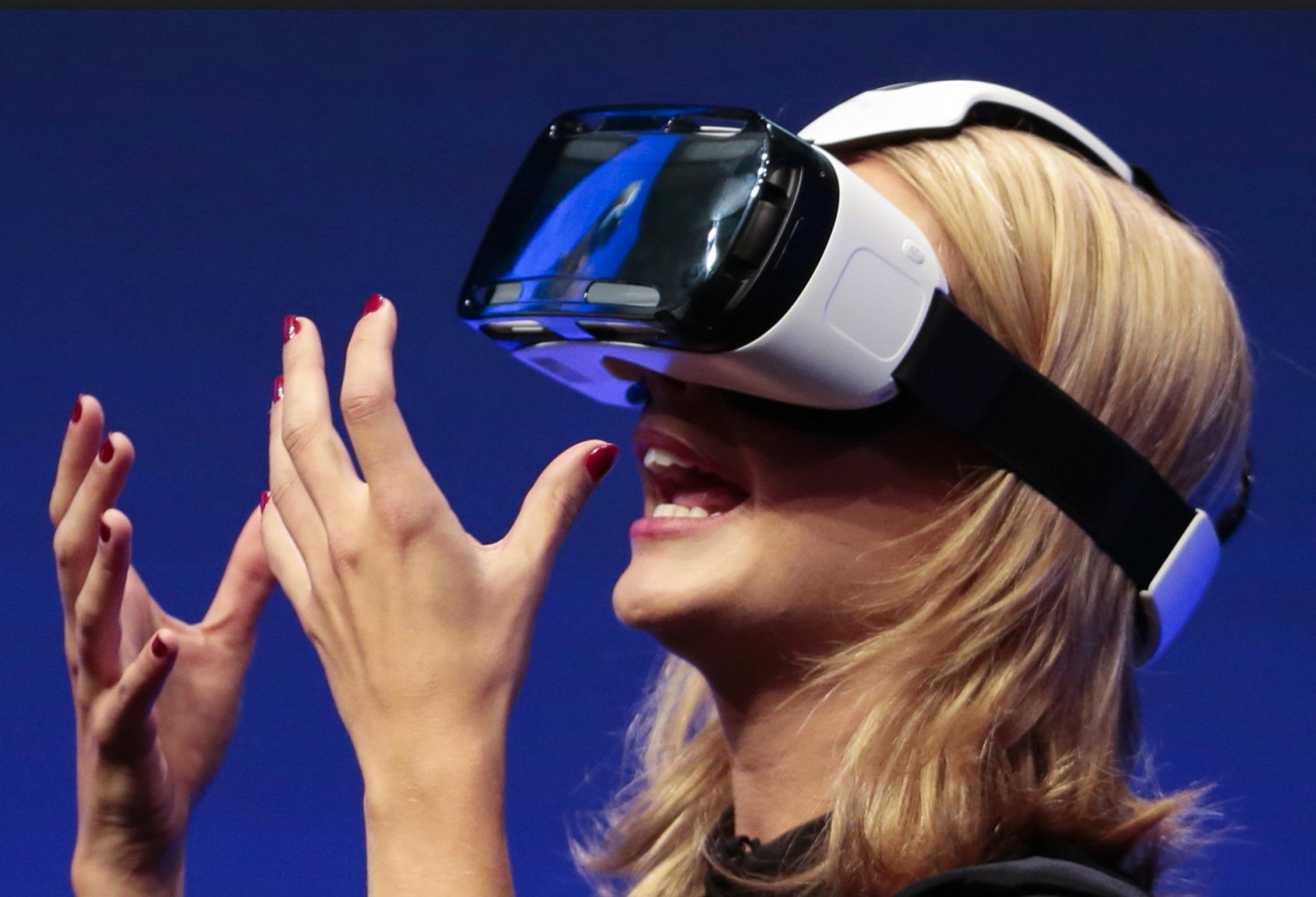
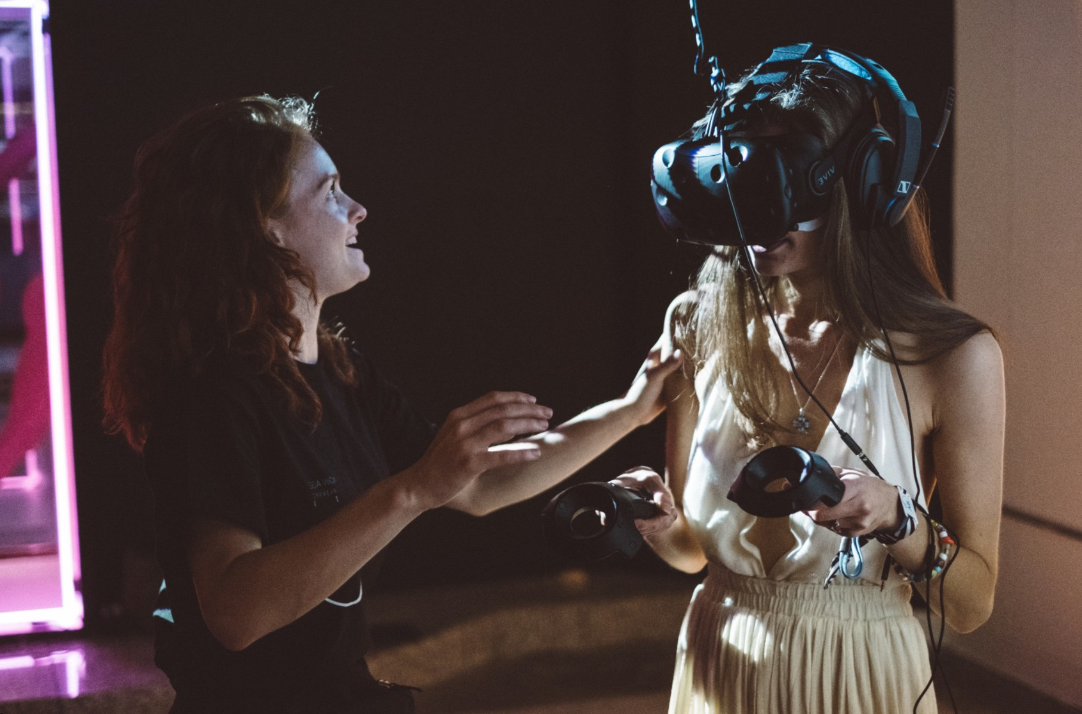
Who are the Users?
Different types of users, must consider them all
Primary: people regularly using the AR/VR system
Secondary: people providing tech support/developing system
Tertiary: people providing funding/space for AR/VR system

Slide 11
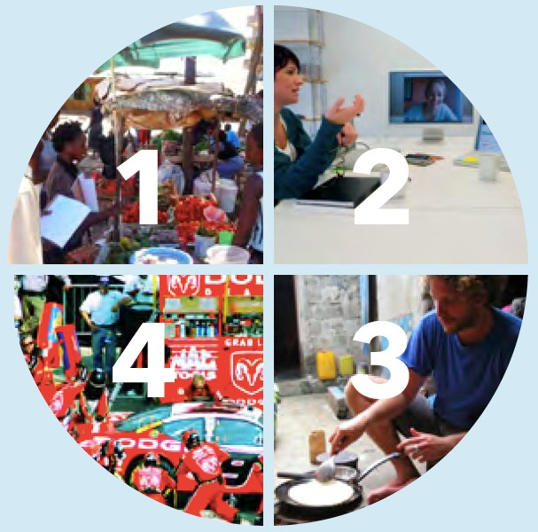
Methods for Identifying User Needs
Learn from people
Learn from Experts
Learn from analogous settings
Immersive yourself in context

Slide 12


Learn from People
Learn from target users by:
Questionnaires and interviewing
Running focus groups
Observing people performing target tasks

Slide 13

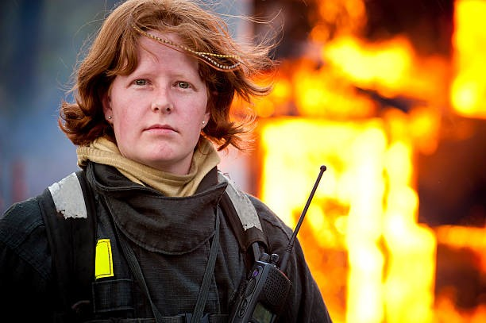

Learn from Experts
Experts have in-depth knowledge about topic
Can give large amount of information in short time
Look for existing process/problem documentation
Choose participants with domain expertise
Expertise, radical opinion, etc.

Slide 14
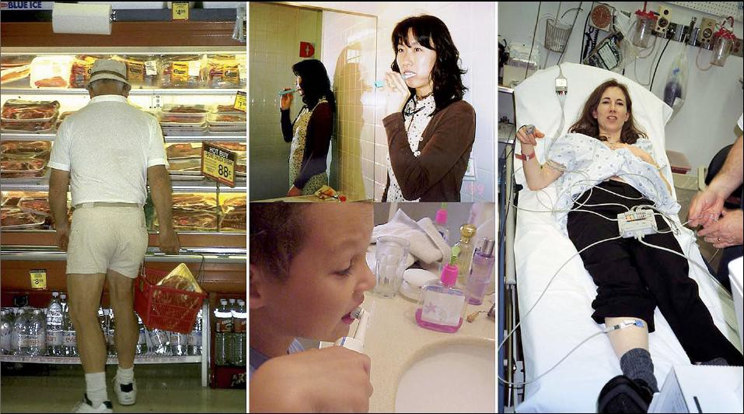
Immersive yourself in Context
Put yourself in the position of the user
Role playing, a day in the life of a user, cultural probes
Observing the problem space around you – how do you feel?
Take notes and capture your observations
A day in the Life of.. Cultural Probes.. Role Playing..

Slide 15

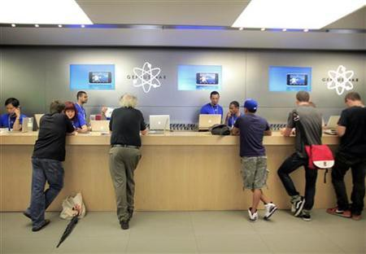
Seek Inspiration in Analogous Setting
Inspiration in different context than problem space
E.g. redesign library by going to Apple store
Think of Analogies that connect with challenge
Similar scenarios in different places
What can public libraries learn from Apple stores?

Slide 16
Identifying User Needs
From understanding the user, look for needs
Human emotional or physical necessities.
Needs help define your design
Needs are Verbs not Nouns
Verbs (activities and desires)
Nouns (solutions)
Identify needs from the user traits you noted, or from contradictions between information
disconnect between what user says and what user does

Slide 17
Is AR/VR the Best Solution?
Not every problem can be solved by AR/VR
Problems Ideal for AR/VR, have:
visual elements
3D spatial interaction
physical manipulation
procedural learning
[AR]need for connection with real world
Problems Not ideal for AR/VR, have:
heavy reading, text editing
many non visual elements
non spatial tasks
need for tactile, haptic, olfaction feedback

Slide 18
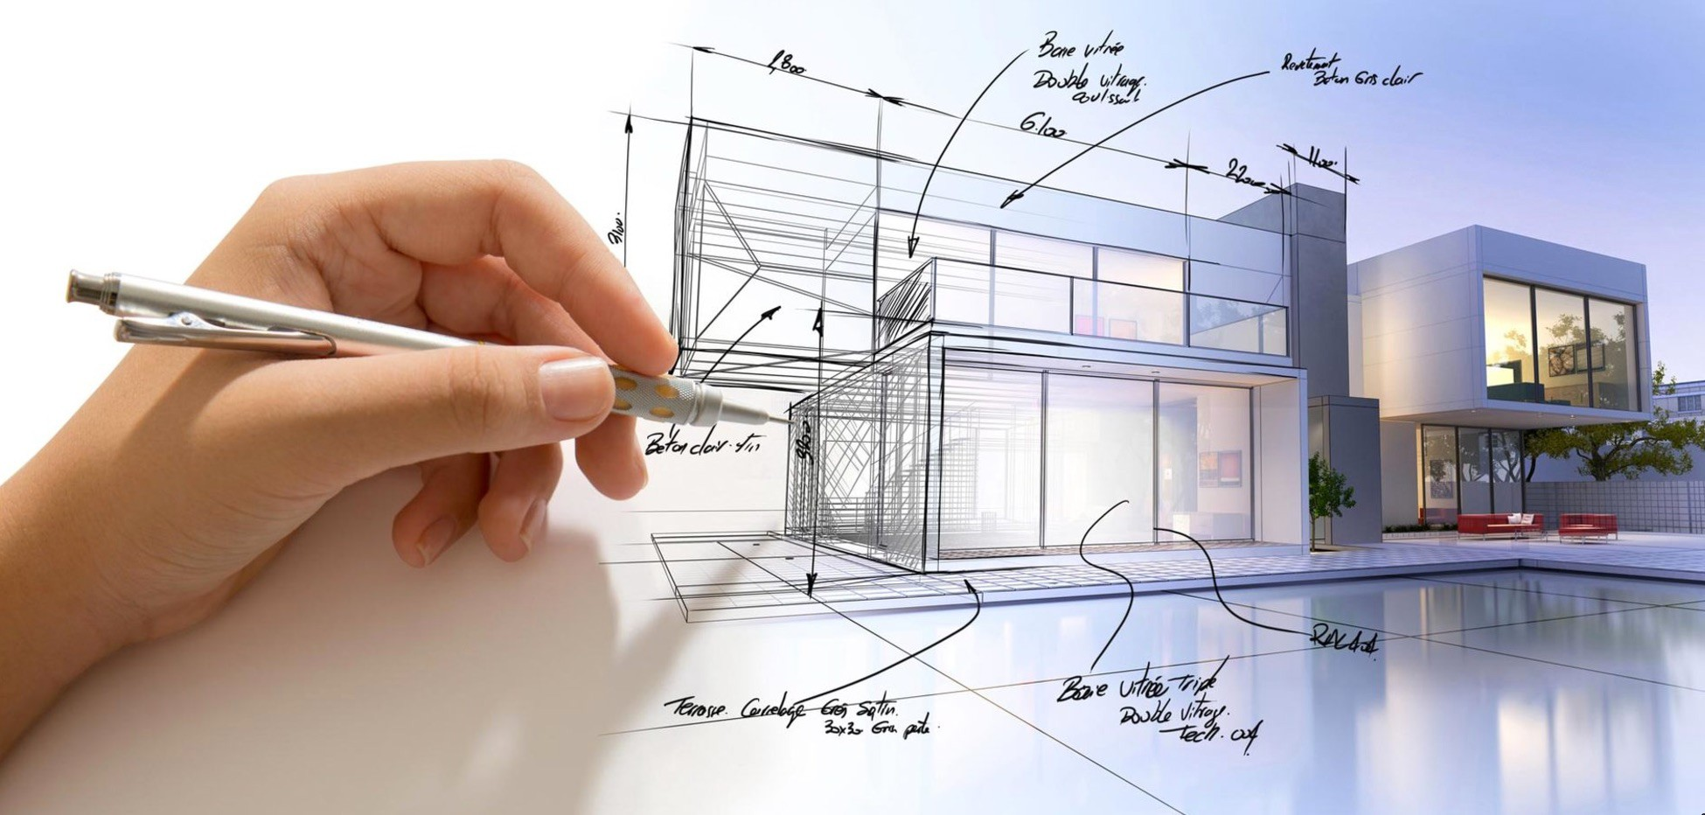
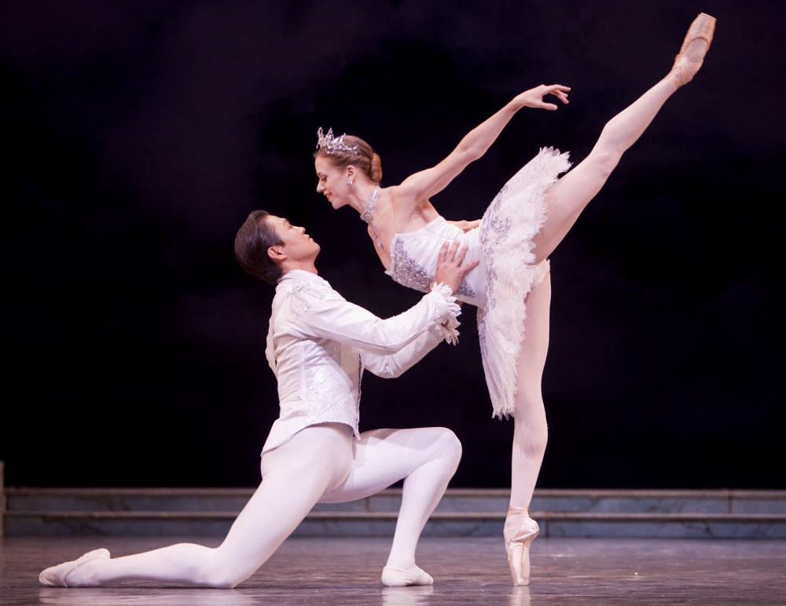


Suitable for VR or not?

Slide 19
Design
Identify needs/ establish requirements
(Re)Design
Evaluate
Build an interactive version
Final Product

Slide 20
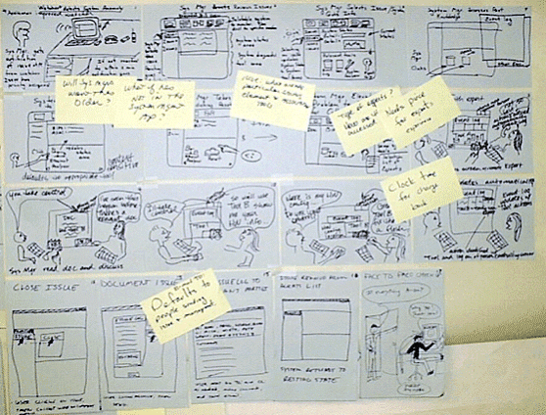
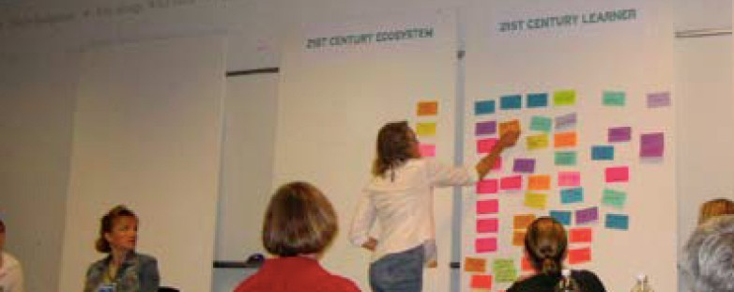
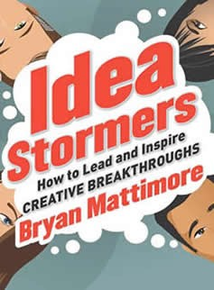
Idea Generation
Once user need is found, solutions can be proposed
Idea generation through:
Brainstorming
Lateral thinking
Ideal storming
Formal problem solving
Etc..

Slide 21
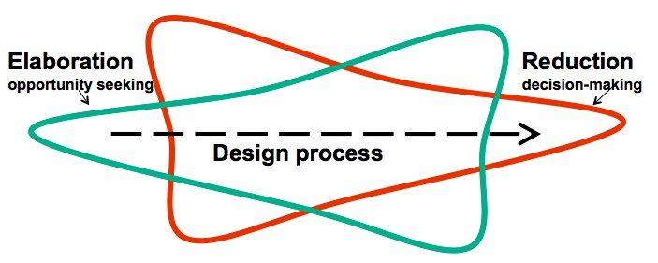
Elaboration and Reduction
Elaborate on Ideas and Reduce to Final Design Direction
Elaborate - generate solutions. These are the opportunities.
Reduce - decide on the ones worth pursuing
Repeat - elaborate and reduce again on those solutions

Slide 22
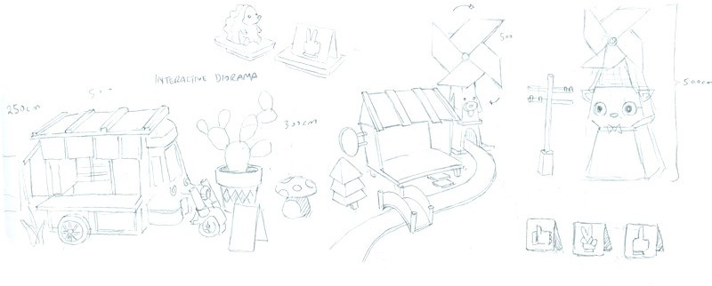
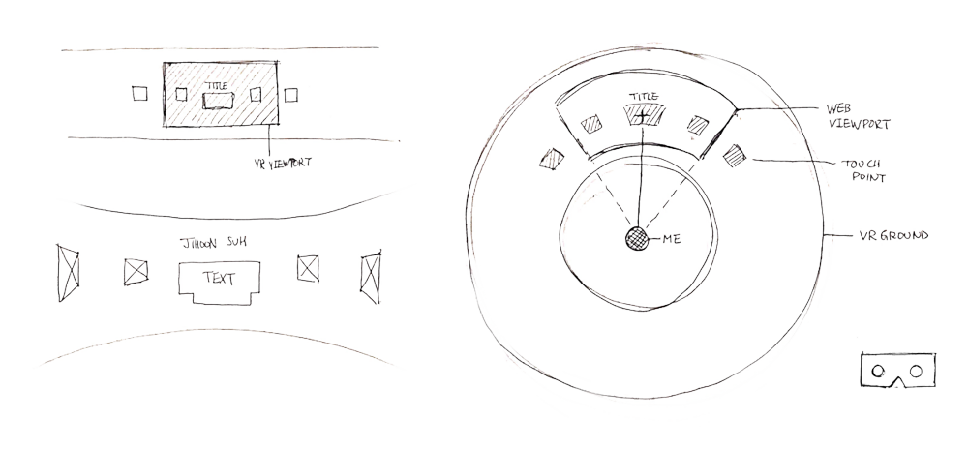
Interface Design Sketches

Slide 23
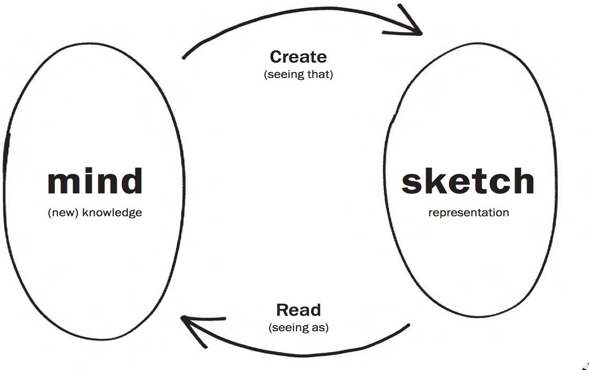
Role of Sketching
Use sketching as way to communicate and create new ideas
“Sketching is about the activity not the result”
Bill Buxton

Slide 24
Why is Sketching Useful?
Early ideation
Think through ideas
Force you to visualize how things come together
Communicate ideas to inspire new designs
Ideal for active brainstorming
Beginning of prototyping process

Slide 25
VR Design Considerations
Use UI Best Practices
Adapt know UI guidelines to VR
Use of Interface Metaphors/Affordances
Decide best metaphor for VR application
Design for Humans
Use Human Information Processing model
Design for Different User Groups
Different users may have unique needs
Design for the Whole User
Social, cultural, emotional, physical cognitive

Slide 26
Use UI Best Practices
General UI design principles can be applied to VR
E.g. Shneiderman’s UI guidelines
Providing interface feedback
Mixture of reactive, instrumental and operational feedback
Maintain spatial and temporal correspondence
Use constraints
Specify relations between variables that must be satisfied
E.g. physical constraints reduce freedom of movement
Support Two-Handed control
Use Guiard’s framework of bimanual manipulation
Dominant vs. non-dominant hands
Ben Shneiderman, Designing the User Interface: Strategies for Effective Human-Computer Interaction, 1997

Slide 27
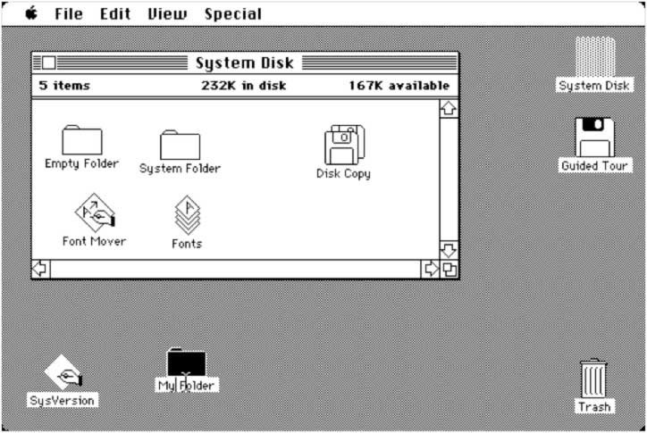
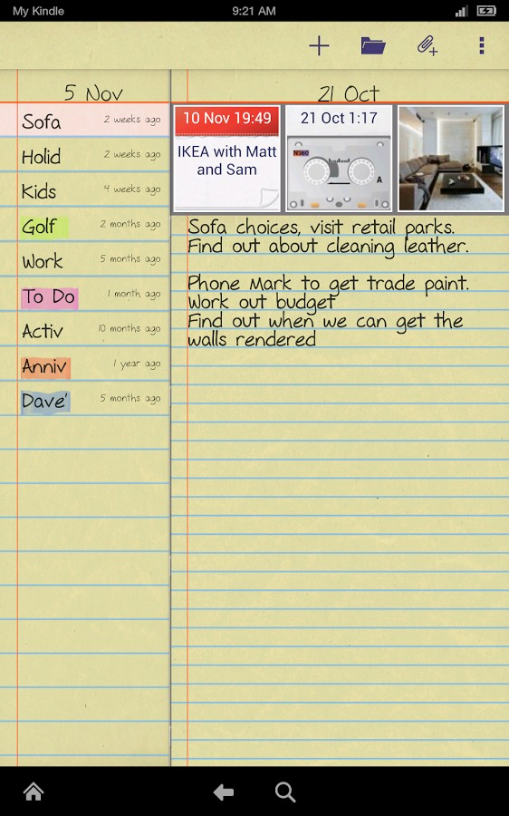

Use Interface Metaphors
Design interface object to be similar to familiar physical object that the user knows how to use
E.g. Desktop metaphor, spreadsheet, calculator
Benefits
Makes learning interface easier and more accessible
Users understand underlying conceptual model

Slide 28
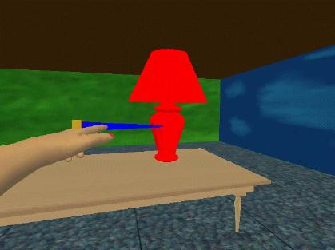
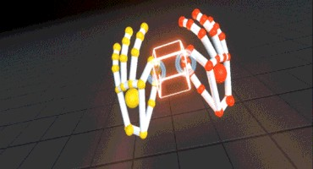
Typical AR/VR Interface Metaphors
Direct Manipulation
Reach out and directly grab objects
Ray Casting
Select objects through ray from head/hand
Vehicle Movement
Move through VR environment through vehicle movement

Slide 29
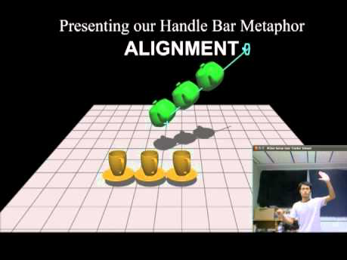
Example: Handle Bar Metaphor
https://youtu.be/VBCP63jD3OI

Slide 30

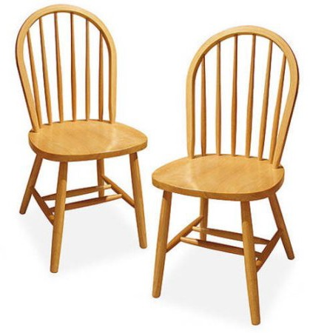
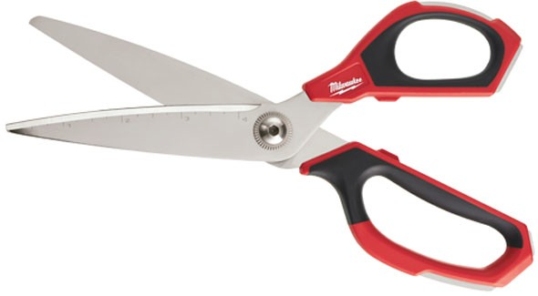
How are These Used?

Slide 31
Affordances
”… the perceived and actual properties of the thing, primarily those fundamental properties that determine just how the thing could possibly be used.
[...]
Affordances provide strong clues to the operations of things.”
Norman, The Psychology of Everyday Things 1988, p.9

Slide 32
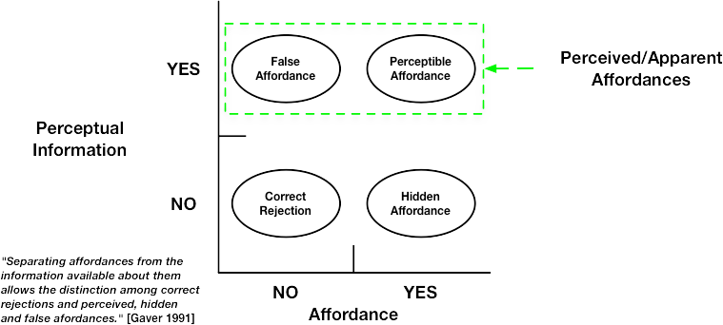
Perceived vs. Actual Affordances
Perceived affordance should match actual affordance

Slide 33
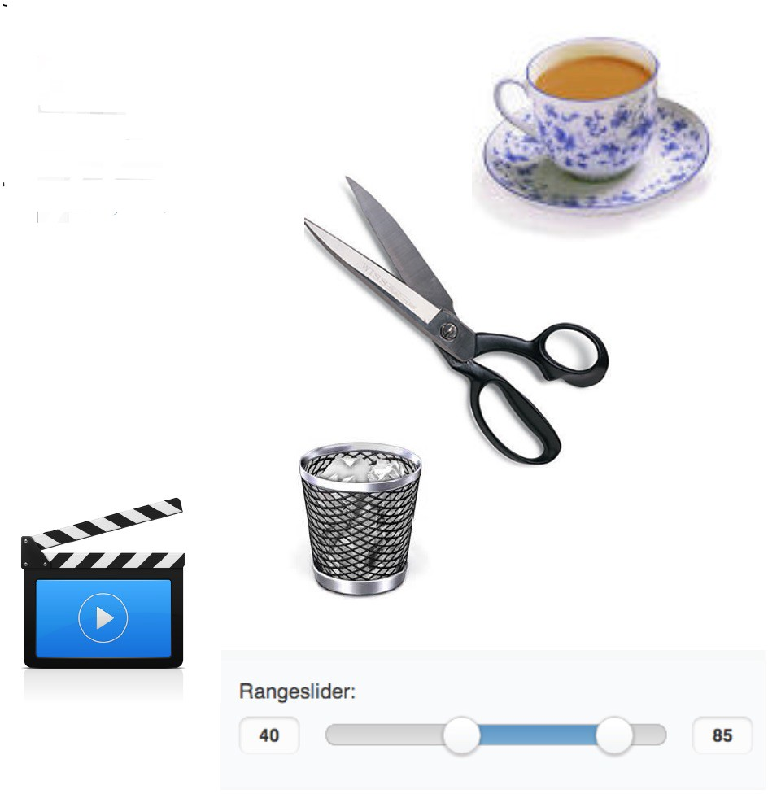
Physical vs. Virtual Affordances
Physical Affordance
Look and feel of real objects
Shape, texture, color, weight, etc.
Industrial Design
Virtual Affordance
Look of virtual objects
Copy real objects
Interface Design

Slide 34
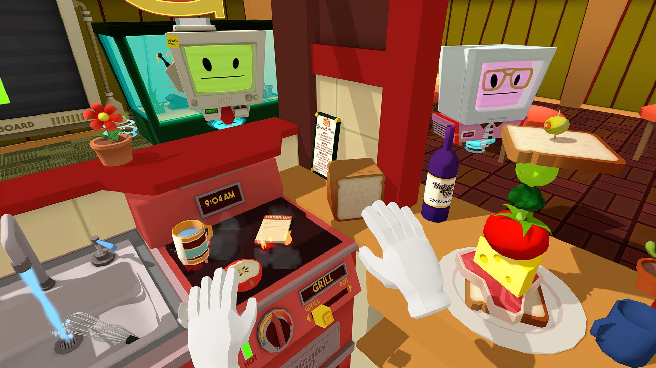
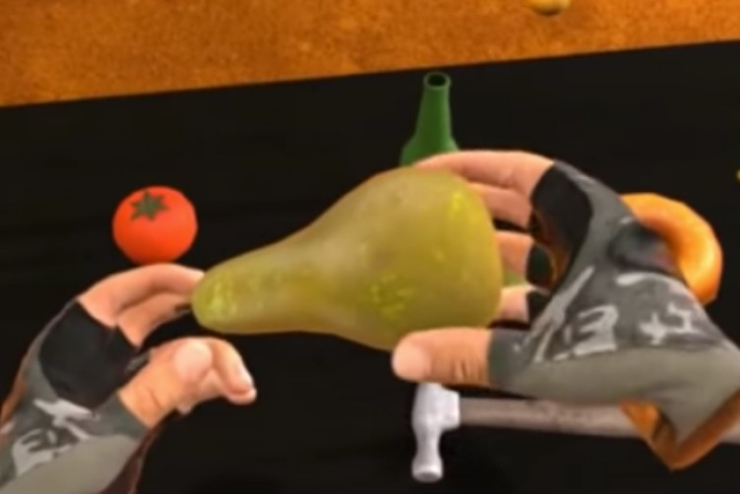
Affordances in AR/VR
Design interface objects to show how they are used
Use visual cues to show possible affordances
Perceived affordances should match actual affordances
Good cognitive model - map object behavior to expected
Familiar objects in Job Simulator Object shape shows how to pick up

Slide 35
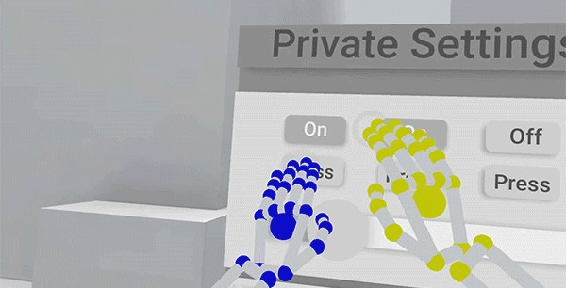

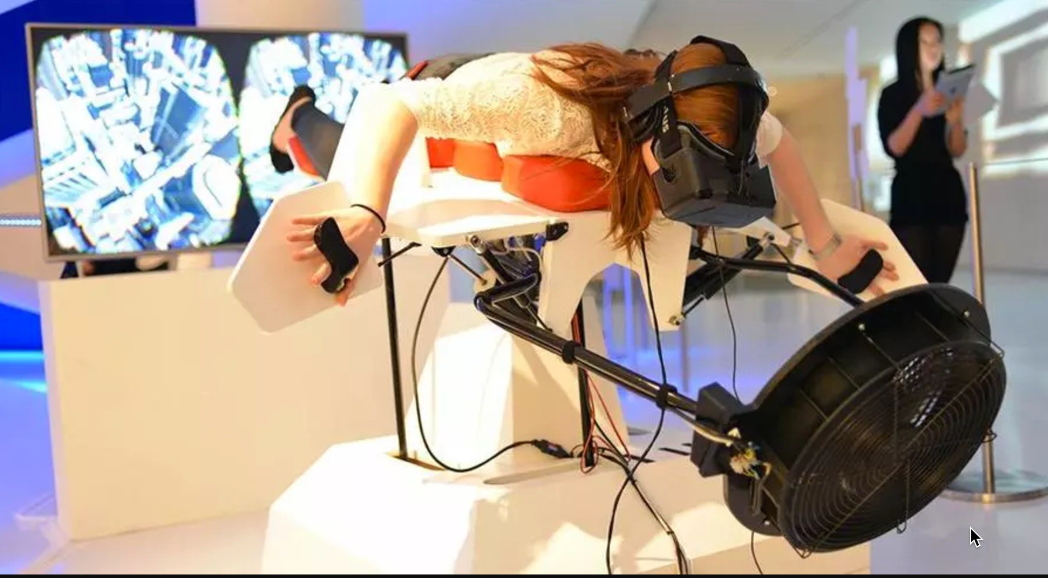

Examples of Affordances in AR/VR
Virtual buttons can be pushed
Virtual doors can be walked through
Flying like a bird in Birdly
Virtual objects can be picked up

Slide 36
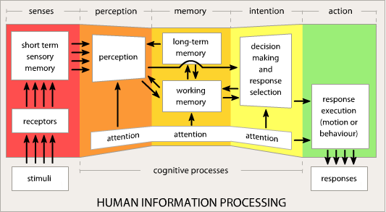
Human Information Processing
High level staged model from Wickens and Carswell (1997)
Relates perception, cognition, and physical ergonomics
Perception Ergonomics
Cognition

Slide 37
Design for Perception
Need to understand perception to design AR/VR
Visual perception
Many types of visual cues (stereo, oculomotor, etc.)
Auditory system
Binaural cues, vestibular cues
Somatosensory
Haptic, tactile, kinesthetic, proprioceptive cues
Chemical Sensing System
Taste and smell

Slide 38
Design for Cognition
Design for Working and Long term memory
Working memory
Short term storage, Limited storage (~5-9 items)
Long term memory
Memory recall trigger by associative cues
Situational Awareness
Model of current state of user’s environment
Used for wayfinding, object interaction, spatial awareness, etc..
Provide cognitive cues to help with situational awareness
Landmarks, procedural cues, map knowledge
Support both ego-centric and exo-centric views

Slide 39
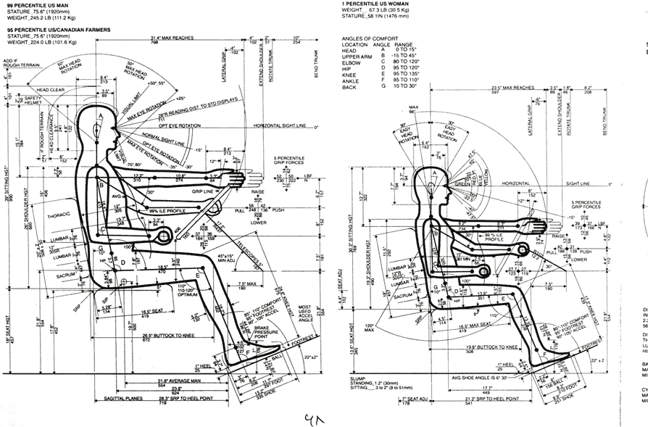
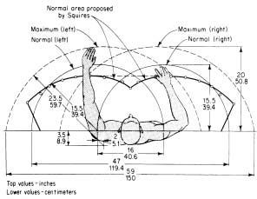
Deisgn for Physical Ergonomics
Design for the human motion range
Consider human comfort and natural posture
Design for hand input
Coarse and fine scale motions, gripping and grasping
Avoid “Gorilla arm syndrome” from holding arm pose

Slide 40
Designing for Different User Groups
Design for Difference Ages
Children require different interface design than adults
Older uses have different needs than younger
Prior Experience with VR systems
Familiar with HMDs, VR input devices
People with Different Physical Characteristics
Height and arm reach, handedness
Perceptual, Cognitive and Motor Abilities
Color perception varies between people
Spatial ability, cognitive or motor disabilities

Slide 41
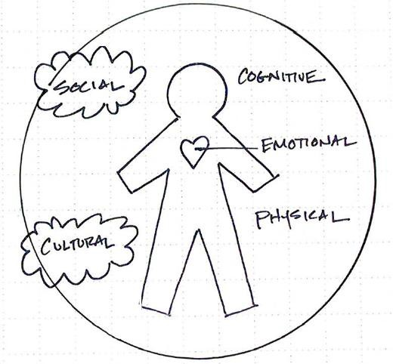
Consider the Whole User Needs

Slide 42
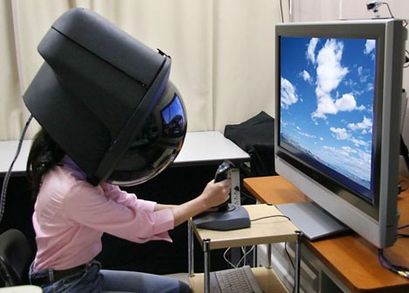
Whole User Needs
Social
Don’t make your user look stupid
Cultural
Follow local cultural norms
Physical
Can the user physically use the interface?
Cognitive
Can the user understand how the interface works?
Emotional
Make the user feel good and in control
Would you wear this HMD?

Slide 43
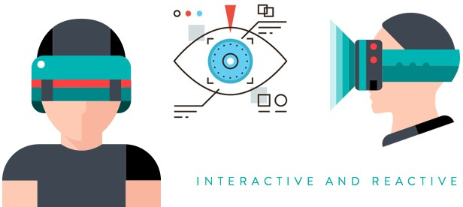
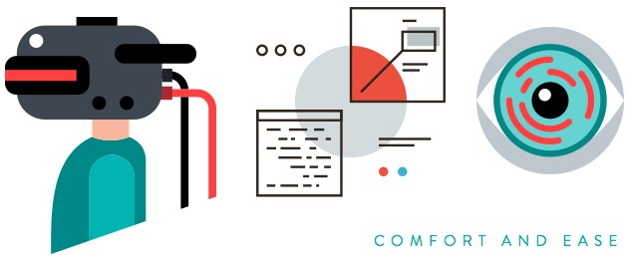
UX Guidelines for VR
The Four Cores of UX Design for VR
Make interface Interactive and Reactive
Design for Comfort and Ease
Use usable Text and Image Scale
Include position audio and 3D sound
https://www.dtelepathy.com/blog/philosophy/ux-guide-designing-virtual-reality-experiences

Slide 44
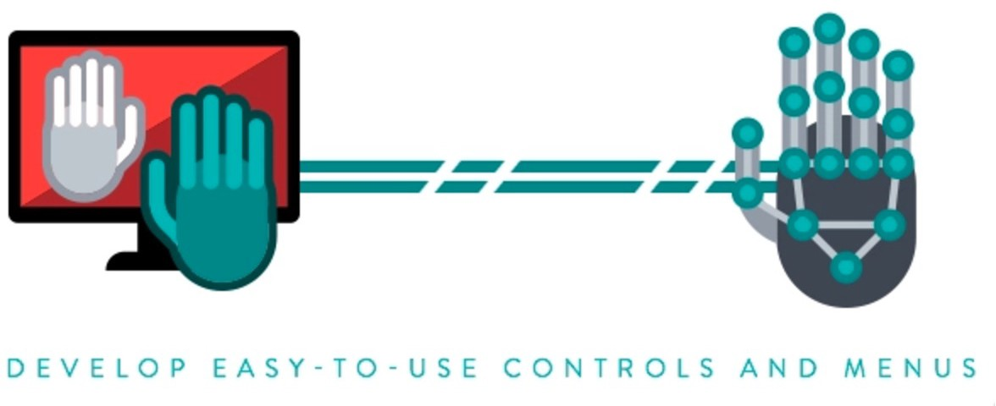
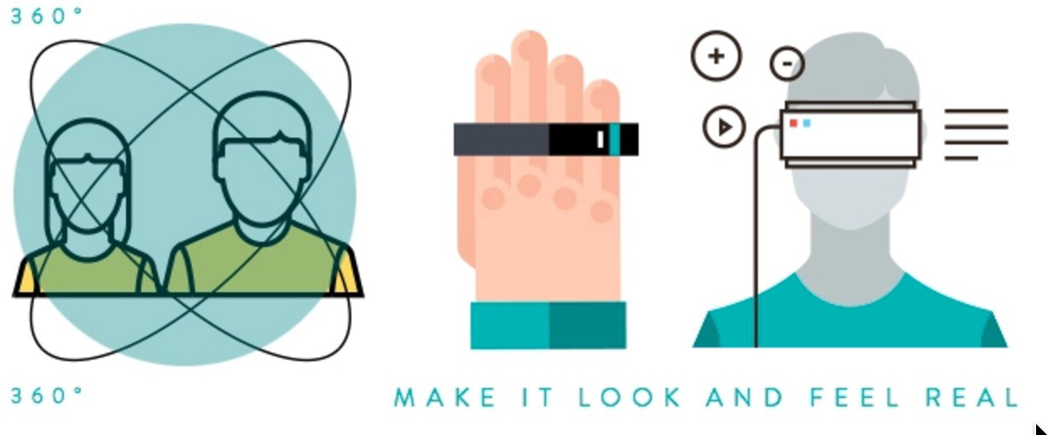
UX Challenges
Problems to be Addressed
Keep the user safe
Make it look and feel real
Make sure users don’t get simulation sickness
Develop easy-to-use controls and menus

Slide 45
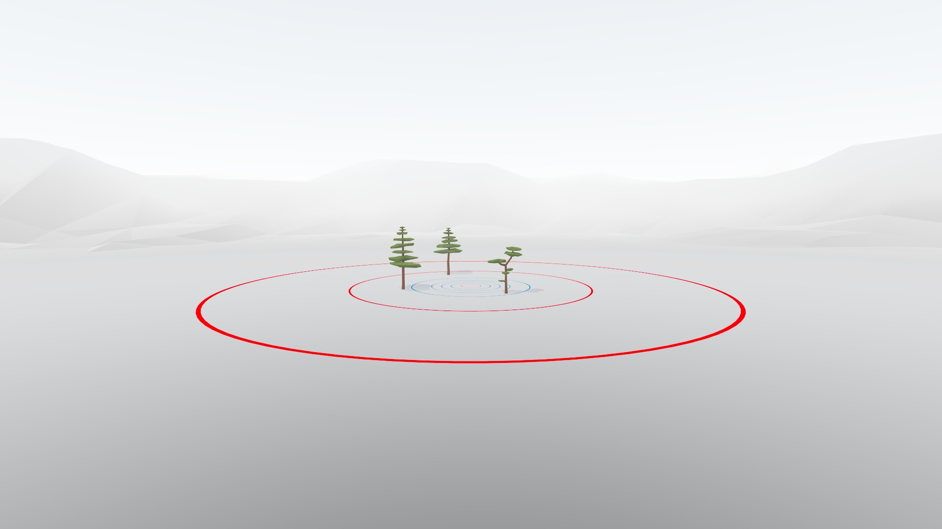
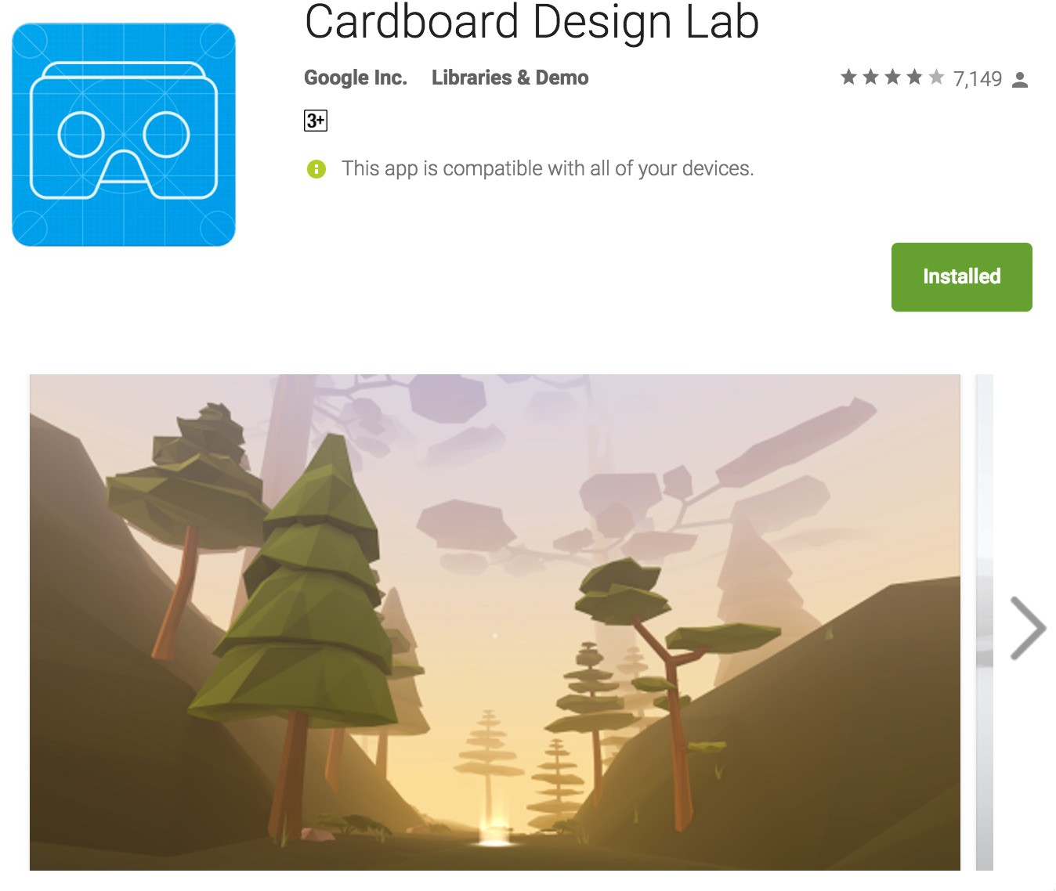
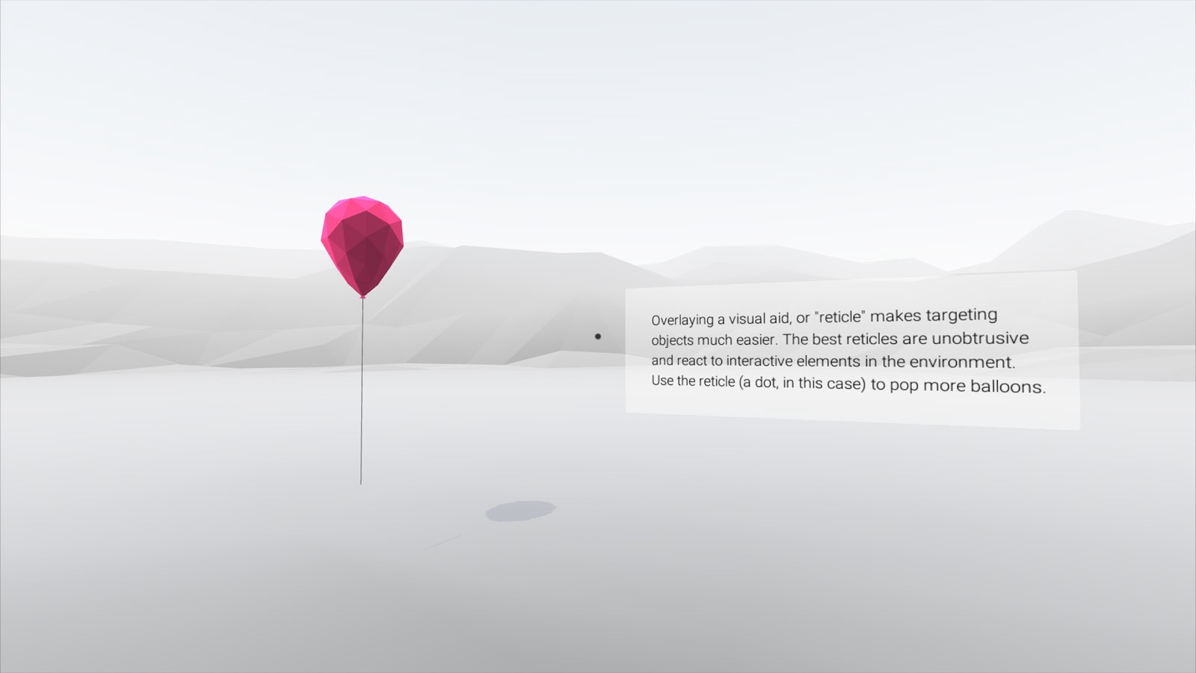
Cardboard Design Lab
Mobile VR App providing examples of best practice VR designs and user interaction (iOS, Play app stores)

Slide 46
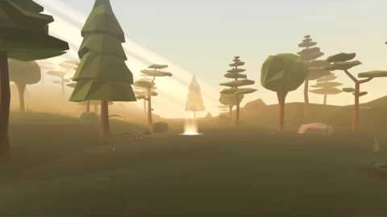
Demo: Cardboard Design Lab
https://youtu.be/2Uf-ru2Ndvc

Slide 47
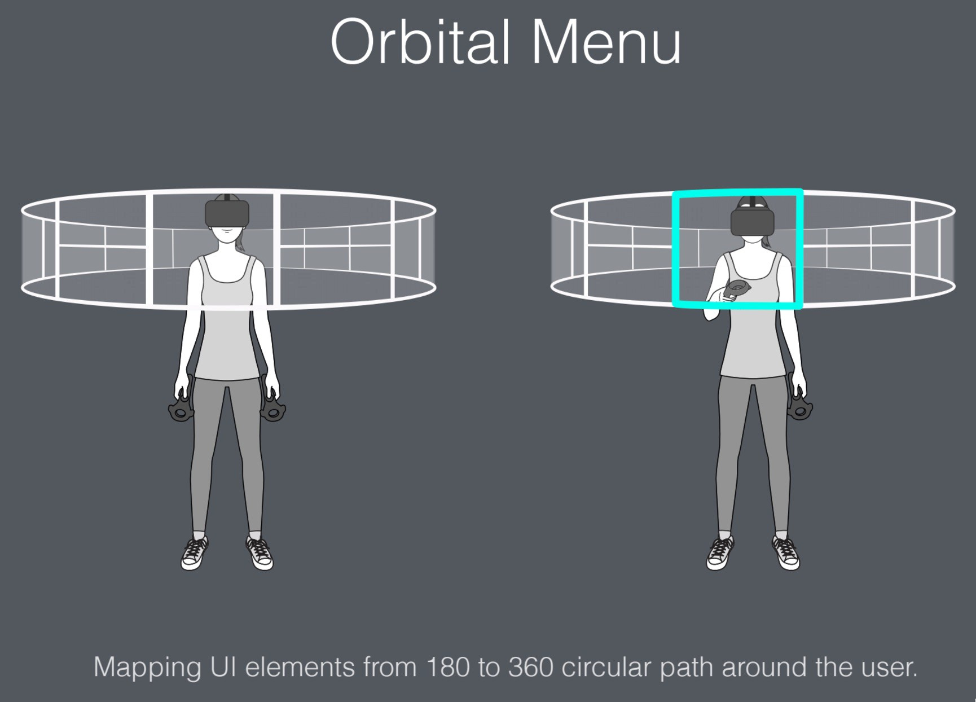

VR Human Interface Guidelines
Interface design website - http://vrhig.com/
Set of VR interface design best practices

Slide 48
Design Guidelines (from 3D UI book)
Design for comfortable poses
Design for relatively short sessions and encourage breaks
Use constraints, use and invent magical techniques
Consider real world tools and practices as a source of inspiration for 3D user interface design
Consider designing 3D techniques using principles from 2D interaction
Consider using physical props and passive feedback, particularly in highly specialized tasks
Ensure temporal and spatial compliance between feedback dimensions

Slide 49


More VR Design Guidelines
Use real-world cues when appropriate.
If there is a horizon line, keep it steady
Be careful about mixing 2D GUI and 3D
Avoid rapid movement, it makes people sick
Avoid rapid or abrupt transitions to the world space
Keep the density of information and objects on screen low
Do not require the user to move their head or body too much
From https://www.wired.com/2015/04/how-to-design-for-virtual-reality/

Slide 50

UX of VR Website
Many examples of great design ideas
Videos, books, articles, slides, code, etc..
http://www.uxofvr.com

Slide 51
Prototyping
Identify needs/ establish requirements
(Re)Design
Evaluate
Build an interactive version
Final Product

Slide 52
Why Prototype?
Quick visual design
Capture key interactions
Focus on user experience
Communicate design ideas
“Learn by doing/experiencing”

Slide 53

From Sketches to Prototypes
Sketches: early ideation stages of design
Prototypes: capturing /detailing the actual design

Slide 54
Sketch vs. Prototype
Sketch | Prototype
Invite | Attend
Suggest | Describe
Explore | Refine
Question | Answer
Propose | Test
Provoke | Resolve
Tentative, non committal | Specific Depiction
The primary differences are in the intent

Slide 55
From Sketches to Prototypes
Early design
Brainstorm different ideas and representations
Choose a representation
Rough out interface style
Task centered walkthrough and redesign
Fine tune interface, screen design
Heuristic evaluation and redesign
Usability testing and redesign
Limited field testing
Alpha/Beta tests
Multitude of sketches
Sketch variations and details Sketch or low fidelity prototypes
Low to medium fidelity prototypes
High fidelity prototypes
Working systems
Late design

Slide 56
Typical Development Steps
Sketching
Storyboards
UI Mockups
Interaction Flows
Video Prototypes
Interactive Prototypes
Final Native Application
Increased Fidelity & Interactivity

Slide 57
Typical Prototyping Tools
Static/Low fidelity
Sketching
User interface templates
Storyboards/Application flows
Interactive/High fidelity
Wireframing tools
Mobile prototyping
Native Coding

Slide 58

Design/Prototyping Tools

Slide 59
Advantages/Disadvantages
Prototype | Advantages | Disadvantages
Low-fidelity | low developmental cost evaluate multiple design concepts | limited error checking navigational and flow limitations
High-fidelity | fully interactive look and feel of final product clearly defines navigational scheme | more expensive to develop time consuming to build developers are reluctant to change something they have crafted for hours

Slide 60
VR Prototyping Tools
Low Fidelity
Sketched Paper Interfaces – pen/paper, non-interactive
Onride Photoshop tool – digital, non-interactive
InstaVR – 360 web based tool, simple interactivity
SketchBox – create VR interface inside VR
High Fidelity
Entiti – template based VR with visual programming
A-Frame – web based VR tool using HTML
EditorVR – Unity wrapper inside VR
Unity/Unreal Game Engine – programming needed

Slide 61


Sketching VR Interfaces
Download 360 panorama template grid
Draw interface ideas into grid
Scan into 360 photo viewer for VR HMD
See https://virtualrealitypop.com/vr-sketches-56599f99b357

Slide 62

Example Sketched VR Interface
https://youtu.be/BmMh6-jPWOc

Slide 63


ONIRIDE - 360° Art Plugin for Photoshop
Draw 360 panorama’s directly in Photoshop
Preview in Photoshop, export to VR
See http://www.oniride.com/360art

Slide 64

OniRide Demo
https://youtu.be/1P1EfGizal0

Slide 65

InstaVR
Free, fast panorama VR, deploy to multi platforms
http://www.instavr.co/

Slide 66

Demo - Using InstaVR
https://youtu.be/M2C8vDL0YeA

Slide 67


Sketchbox
VR design tool - create VR interface inside VR
Support for HTC Vive, Oculus Rift
Easy to use VR sketching tool
Available from SteamVR
See https://www.sketchboxvr.com/

Slide 68

Sketchbox Demo
https://youtu.be/gWfgewGzaEI

Slide 69

Entiti
Stand alone application for VR/AR authoring (Windows, Mac)
Works with Entiti mobile application (Android, iOS)
Delivers multiple VR experiences – 360 and 3D scenes
Template based VR, Visual programming for behaviors
https://www.wakingapp.com/

Slide 70

Entiti Overview
https://youtu.be/tmOAfrM4GvY

Slide 71


A-Frame
Web based VR framework
Make WebVR with HTML and Entity-Component
Works on Vive, Rift, Daydream, GearVR, desktop
See https://aframe.io/

Slide 72

A-Frame Demo
https://youtu.be/1MskH9uqOyQ

Slide 73


Unity EditorVR
Edit Unity VR scenes inside VR
3D user interface on top of Unity
2 handed interface using HTC Vive
Support for multi-user input
Available from https://github.com/Unity-Technologies/EditorVR

Slide 74

Demo: Unity EditorVR
https://youtu.be/ILe2atyofqM

Slide 75



More Prototyping Tools
List of 24 prototyping tools
Tools for prototyping 3D VR experiences
Tools for prototyping 360 degree experiences
Web based Tools for 3D prototyping
3D modeling tools in VR
See http://bit.ly/2wx3i6H

Slide 76

EXAMPLE: CONCEPT TO DEMO
NASA Hololens AR/VR Concept Demo
Vision: Work on Mars from your office
Story and sketches based on vision
Led to working Demo

Slide 77

Chesley Bonestell (1940s)

Slide 78

Hololens Story

Slide 79



HoloLens Concept Sketches

Slide 80

Final NASA HoloLens OnSight Demo
https://youtu.be/DXT-ynvI3Lg

Slide 81
Evaluation
Identify needs/ establish requirements
(Re)Design
Evaluate
Build an interactive version
Final Product

Slide 82
What is evaluation?
Evaluation is concerned with gathering data about the usability of a design or product by a specified group of users for a particular activity within a specified environment or work context

Slide 83
When to evaluate?
Once the product has been developed
pros : rapid development, small evaluation cost
cons : rectifying problems
During design and development
pros : find and rectify problems early
cons : higher evaluation cost, longer development
design implementation evaluation
redesign & reimplementation

Slide 84
Four Evaluation Paradigms
‘quick and dirty’
usability testing (including lab studies)
field studies
predictive evaluation

Slide 85

Quick and Dirty
Informal feedback from users or consultants to confirm that their ideas are in-line with users’ needs and are liked.
Quick & dirty evaluations are done any time.
Emphasis is on fast input to the design process rather than carefully documented findings.

Slide 86
Usability Testing
Recording typical users’ performance on typical tasks in controlled settings.
As the users perform tasks they are watched & recorded on video & their inputs are logged.
User data is used to calculate performance times, errors & help determine system usability
User satisfaction questionnaires & interviews are used to elicit users’ opinions.

Slide 87


Laboratory-based studies
Controlled, instrumented environment
can be used for evaluating the design, or system
are carried out in an interruption-free usability lab
can accurately record some work situations
some studies are only possible in a lab environment
some tasks can be adequately performed in a lab
useful for comparing different designs in a controlled context

Slide 88
Field/Ethnographic Studies
Field studies are done in natural settings
The aim is to understand what users do naturally and how technology impacts them.
In product design field studies can be used to:
identify opportunities for new technology
determine design requirements
decide how to introduce new technology
evaluate technology in use.

Slide 89
Predictive Evaluation
Experts apply their knowledge of typical users, often guided by heuristics, to predict usability problems.
Can involve theoretically based models.
A key feature of predictive evaluation is that users need not be present
Relatively quick and inexpensive

Slide 90
Characteristics of Approaches
 | Quick and dirty | Usability testing | Field studies | Predictive
Users | anyone | do task | natural | not involved
Location | anywhere | controlled | natural | anywhere
When | prototype | prototype | early | prototype
Data | qualitative | quantitative | qualitative | problems
Feedback | observations | measures & errors | descriptions | problems
Type | ad-hoc | applied | naturalistic | expert

Slide 91
Evaluation Approaches and Methods
Method | Quick and Dirty | Usability testing | Field studies | Predictive
Observing | x | x | x
Asking users | x | x | x
Asking experts |  |  | x | x
Testing |  | x
Modeling |  |  |  | x

Slide 92
DECIDE: A framework to guide evaluation
Determine the goals the evaluation addresses.
Explore the specific questions to be answered.
Choose the evaluation paradigm and techniques to answer the questions.
Identify the practical issues.
Decide how to deal with the ethical issues.
Evaluate, interpret and present the data.

